Slide 1

Innovating Big Data Analytic
Presentation for
IEDE TSINGHUA UNIVERSITY
September 28, 2018
GROUP LEADER KONJOH SELABI ELVIS
MEMBERS:
BUKUMBA BIJANU AMANY
LEMDJOU YANICK BRICE
MEYOF KWEYUI NGONGANG MARK
KETCHAYA YANICK BLAISE

Slide 2
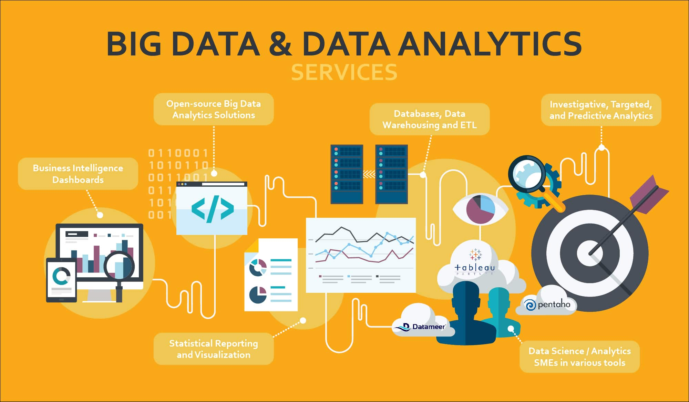
OUTLINE
Overview
New paradigm?
Relationship with other fields
The future of Big Data

Slide 3
What is Big Data?
Massive sets of unstructured/semi-structured data from Web traffic, social media, sensors, etc
Petabytes, exabytes of data
Volumes too great for typical DBMS
Information from multiple internal and external sources:
Transactions
Social media
Enterprise content
Sensors
Mobile devices
In the last minute there were …….
204 million emails sent
61,000 hours of music listened to on Pandora
20 million photo views
100,000 tweets
6 million views and 277,000 Facebook Logins
2+ million Google searches
3 million uploads on Flickr

Slide 4
What is Big Data? continued
Companies leverage data to adapt products and services to:
Meet customer needs
Optimize operations
Optimize infrastructure
Find new sources of revenue
Can reveal more patterns and anomalies

Slide 5
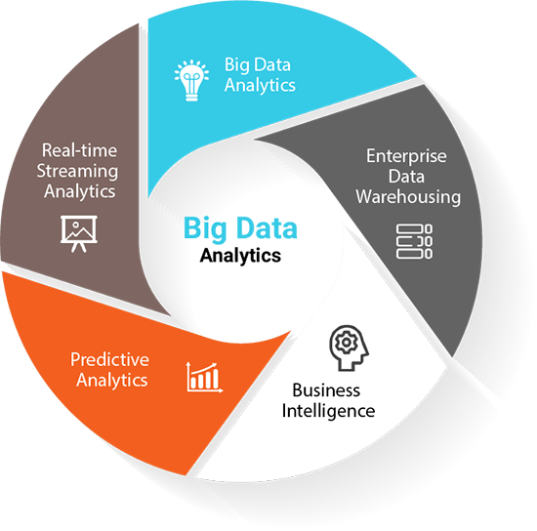
Overview

Slide 6
Where does Big Data come from?
Email
Transactions
Enterprise “Dark Data”
Partner, Employee Customer, Supplier
Contracts
Monitoring
Public
Commercial
Sensor
Credit
Weather
Social Media
Industry
Population
Sentiment
Economic
Network

Slide 7
Why is Big Data So Important?
Here are a few of the most important ways big data can transform an organization:
Business intelligence: weapon in the fight for the modern market
Innovation : big data is used to drive new, creative products and tools to market
Lowered cost of ownership: IT professionals measure operations not by the price tags on equipment, but on a variety of factors, including annual contracts, licensing, and personnel overhead.

Slide 8
Types of Data
When collecting or gathering data we collect data from individuals cases on particular variables.
A variable is a unit of data collection whose value can vary.
Variables can be defined into types according to the level of mathematical scaling that can be carried out on the data.
There are four types of data or levels of measurement:
1. Categorical (Nominal) [customer’s location (America, Europe, Asia)]
2. Ordinal [college football rankings]
3. Interval [Scale data]
4. Ratio [Scale data]

Slide 9
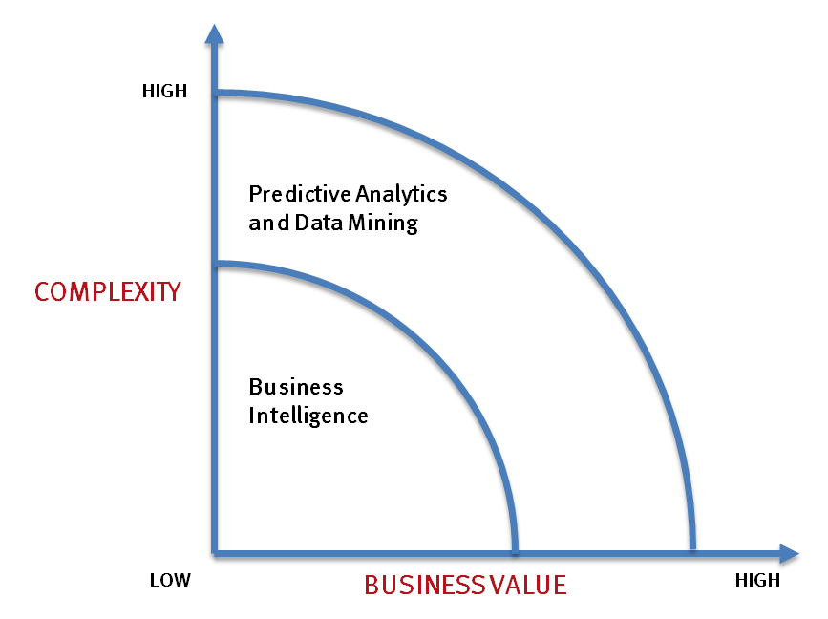
What’s driving Big Data
- Optimizations and predictive analytics
- Complex statistical analysis
- All types of data, and many sources
- Very large datasets
- More of a real-time
- Ad-hoc querying and reporting
- Data mining techniques
- Structured data, typical sources
- Small to mid-size datasets

Slide 10
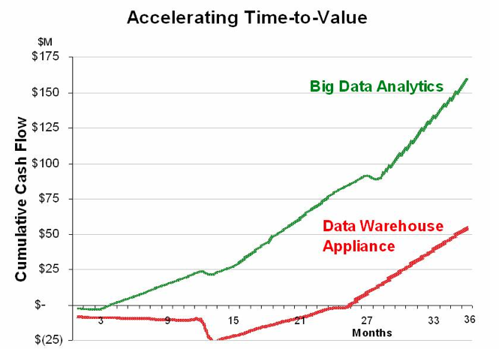
Value of Big Data Analytics
Big data is more real-time in nature than traditional DW applications
Traditional DW architectures (e.g. Exadata, Teradata) are not well-suited for big data apps
Shared nothing, massively parallel processing, scale out architectures are well-suited for big data apps

Slide 11




Big Data Characteristics
Growing quantity of data
e.g. social media, behavioral, video
VOLUME
VARIETY
Quickening speed of data
e.g. smart meters, process monitoring
VELOCITY
VERACITY
Increase in types of data
e.g. app data, unstructured data
Need of veracity in the use of data
e.g. developing trust

Slide 12
Big Data Characteristics (Count..)
Big data gives you the ability to achieve superior value from analytics on
data at higher volumes,
velocities,
varieties
veracities.
With higher data volumes, you can take a more holistic view of your subject’s past, present and likely future.
Notes:
Big data gives you the ability to achieve superior value from analytics on data at higher volumes, velocities, varieties or veracities. With higher data volumes, you can take a more holistic view of your subject’s past, present and likely future.
At higher data velocities, you can ground your decisions in continuously updated, real-time data.
With broader varieties of data, you can have a more nuanced view of the matter at hand.
And as data veracity improves, you can be confident that you’re working with the truest, cleanest, most consistent data.

Slide 13
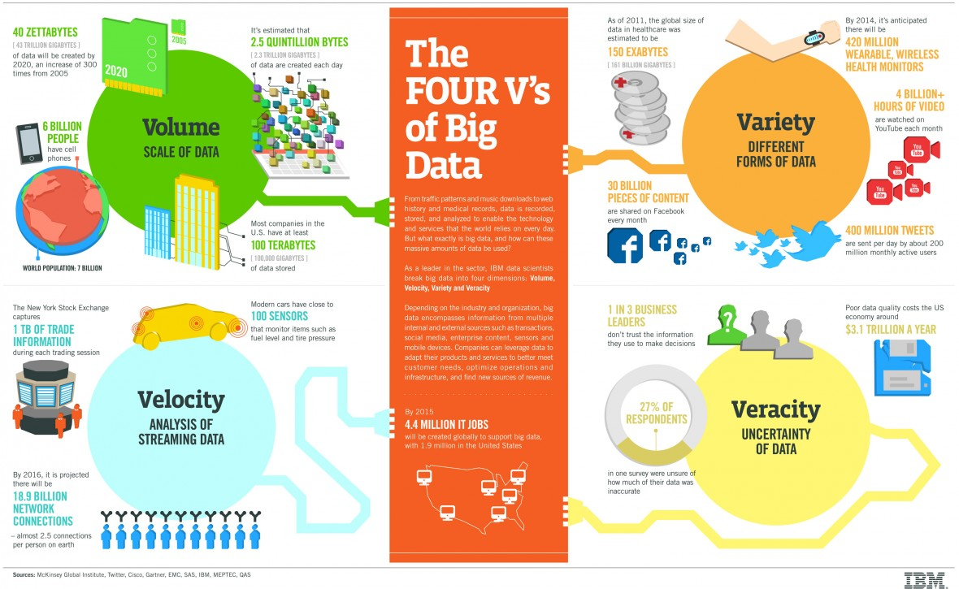

Slide 14
The New Analytic Paradigm
You will be expected to do something with information
There really is more to know
You will have to know more about knowing
Brain science and decision science are converging
The environment is changing our brain
Information management is the essence of leadership
A more connected world means much more data is available (and accessible)
Math matters (but so does logic and rules)
There are significant downsides to not knowing
Knowing can change the world

Slide 15
What Technology Do We Have
For Big Data ??

Slide 16
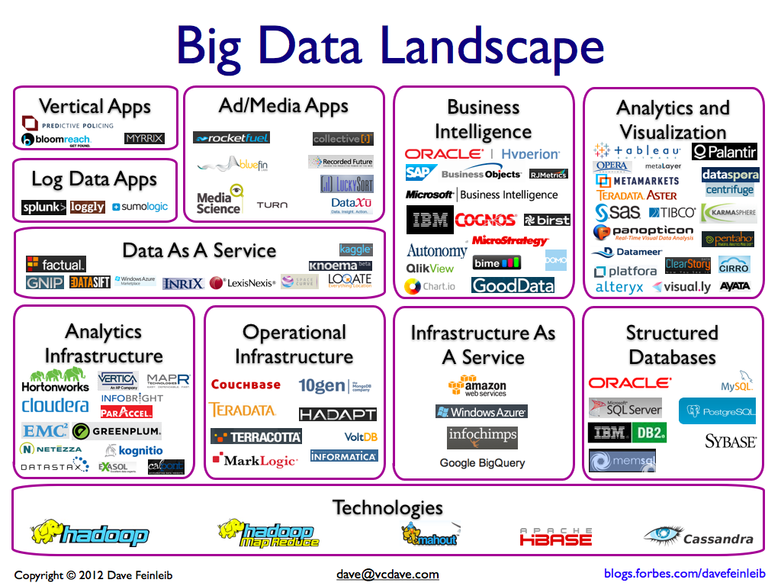

Slide 17
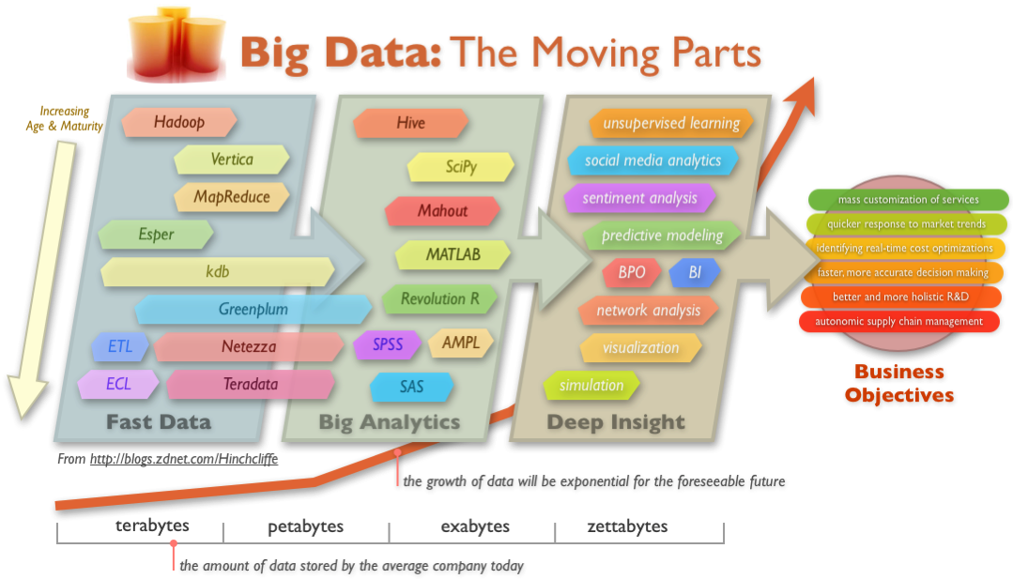
Big Data Technology

Slide 18
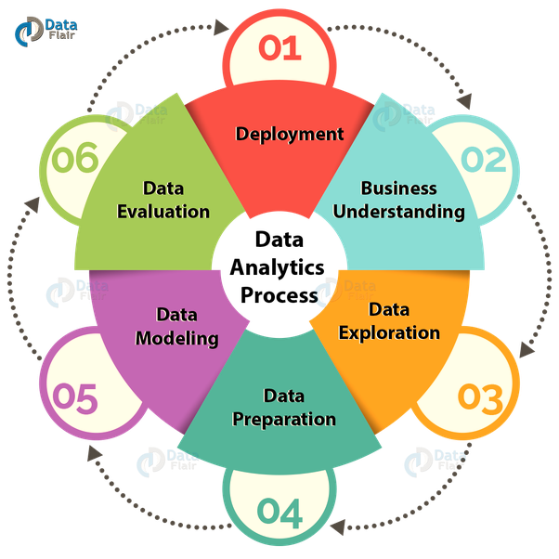
Big Data Techniques
Association Rule Learning
Classification Tree analysis
Genetic algorithms
Machine Learning
Regression analysis
Sentiment Analysis
Social network analysis

Slide 19
Relation between big Data and other fields
HEALTH CARE | ECONOMY | DATA MINING | AGRICULTURE | HADOOP
Traditionally, the health care industry has lagged behind other industries in the use of big data Health care stakeholders now have access to promising new threads of knowledge. | Designed from the ground up to deal intelligently with commodity hardware, Hadoop can help organizations transition to low-cost servers. | Decision trees automatically help users understand what combination of data attributes result in a desired outcome.. | Uses sensor data to optimize crop efficiency. The simulations allow it to discover the optimal environmental conditions for specific gene types. | In every vertical there are data tasks with which Hadoop can assist. These tasks have different terms depending on the industry but they all come down to either advanced analytics or data processing.

Slide 20
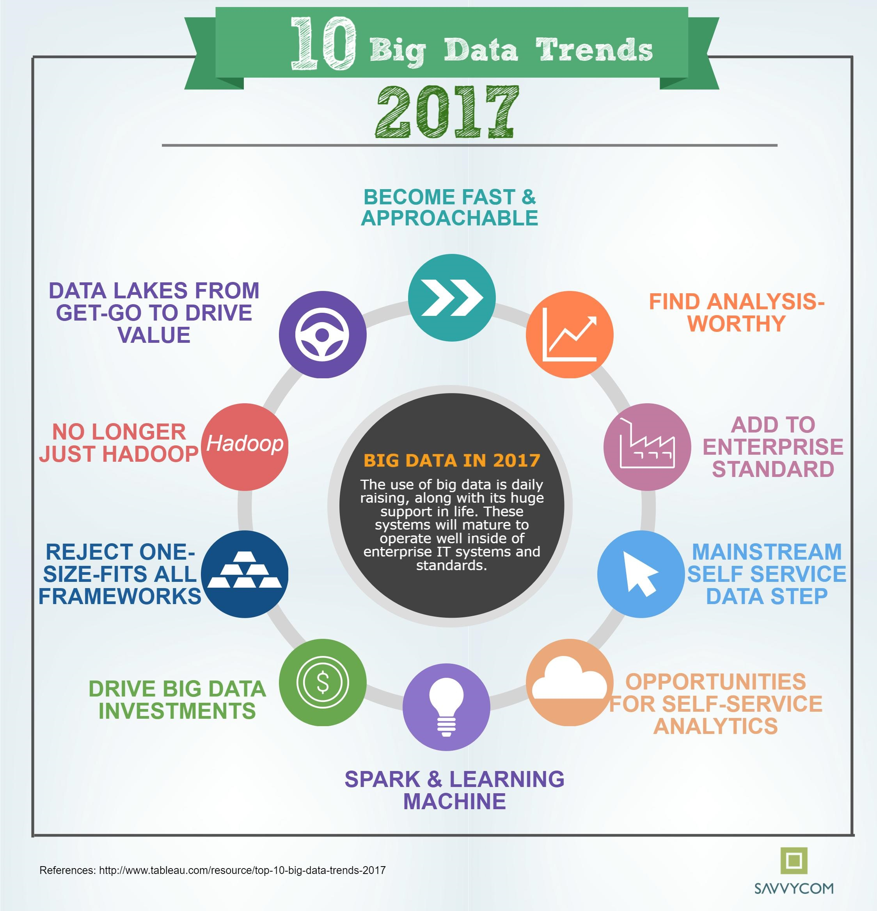
Big Data Trends
BIG DATA
Big Data Intelligent Apps
Self-Service
Big Data and Open Source
In-Memory Technology
Machine Learning
Predictive Analytics
Intelligent Security
IoT
Edge Computing
High Salaries

Slide 21
Big Data Trends
1. Big Data and Open Source
2-Machine Learning
3-Big Data Intelligent Apps
Experts say that in 2017, many enterprises will expand their use of Hadoop and NoSQL technologies, as well as looking for ways to speed up their big data processing.
Many will be seeking technologies that allow them to access and respond to data in real time.
As big data analytics capabilities have progressed, some enterprises have begun investing in machine learning (ML).
Another way that enterprises are using machine learning and AI technologies is to create intelligent apps.
These applications often incorporate big data analytics, analyzing users' previous behaviors in order to provide personalization and better service.
4- IoT
5- Edge Computing
6- Self-Service
The Internet of Things is also likely to have a sizable impact on big data.
According to a September 2016 report from IDC, "31.4 percent of organizations surveyed have launched IoT solutions, with an additional 43 percent looking to deploy in the next 12 months."
One new technology that could help companies deal with their IoT big data
As the cost of hiring big experts rises, many organizations are likely to be looking for tools that allow regular business professionals to meet their own big data analytics needs.

Slide 22
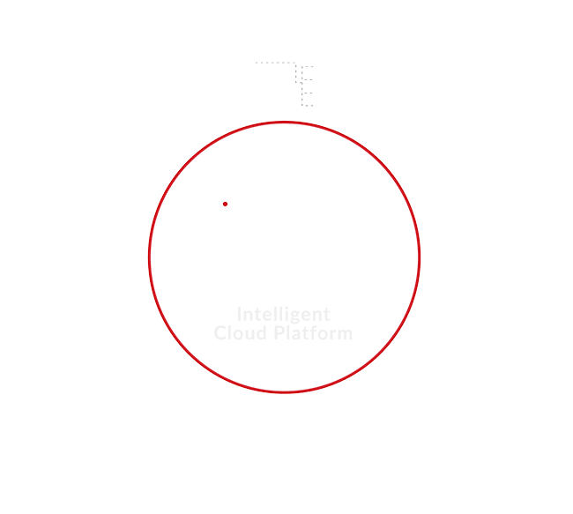
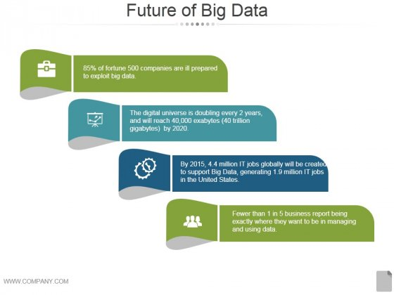
FUTURE FOR BIG DATA

Slide 23
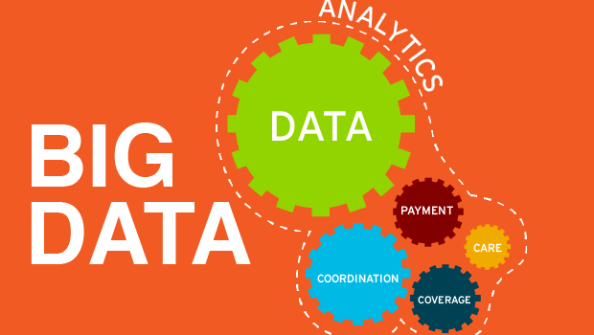
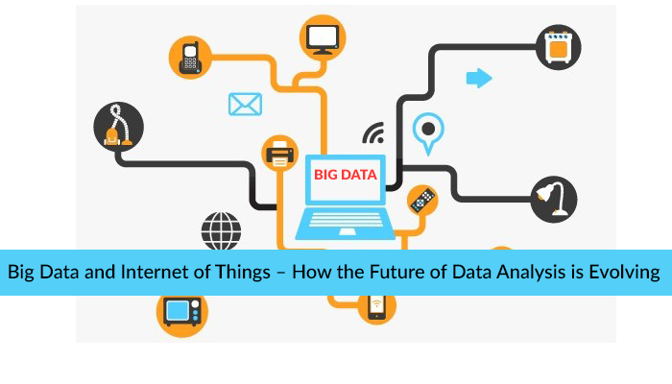

Slide 24
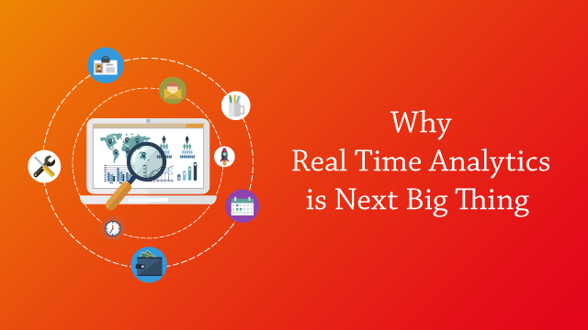
Real time analytics
So Fast data is not about just volume of data like Data Warehouses in which data is measured in GigaBytes, TeraBytes or PetaBytes.
Instead, we measure volume but concerning its incoming rate like MB per second, GB per hour, TB per day.
So Volume and Velocity both are considered while talking about Fast Data.

Slide 25
Big data isn’t just an important part of the future, it may be the future itself. The way that business, organizations, and the IT professionals who support them approach their missions will continue to be shaped by evolutions in how we store, move and understand data.
Talent’s CEO

Slide 26

Q & A

Slide 27

THANK YOU!

